Slide 1
A One-way Speed of Light
(Not the Lorentz Transform)

Slide 2
Developing The Math
What would a faster than light traveler look like to a stationary observer?
Givens
Light propagates through space at a constant speed
Light originates in space at some point of emission
The direction and speed of the emitter does not change the speed of light
The observer is some distance from the path of the traveler
The observer has perfect stereoscopic vision and can tell direction and distance to an emitted point.

Slide 3
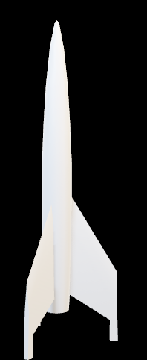




$$VT−L$$
$$VT$$
$$VT+L$$
$$D$$

Slide 4







$$VT−L$$
$$VT$$
$$VT+L$$
$$T_{O}=T_{E}+\frac{\sqrt{D^{2}+{\left(VT_{E}−L\right)}^{2}}}{C}$$
$$T_{O}=T_{E}+\frac{\sqrt{D^{2}+{\left(VT_{E}\right)}^{2}}}{C}$$
$$D$$
$$T_{O}=T_{E}+\frac{\sqrt{D^{2}+{\left(VT_{E}+L\right)}^{2}}}{C}$$

Slide 5
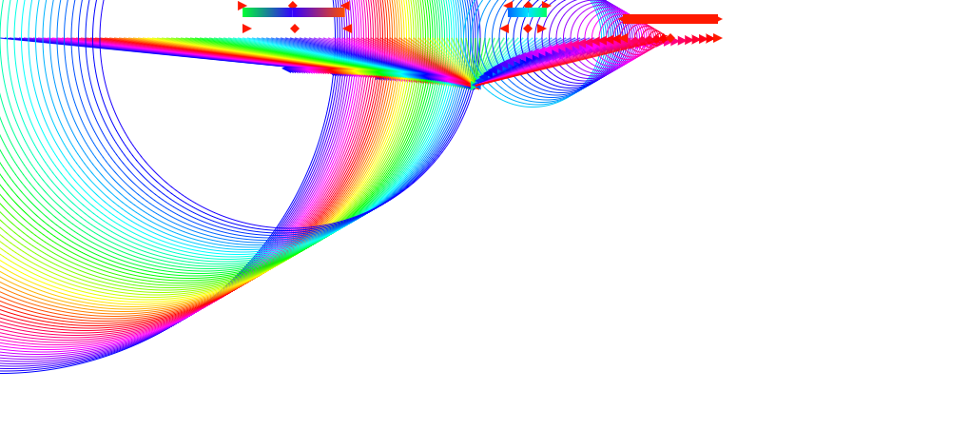

Slide 6



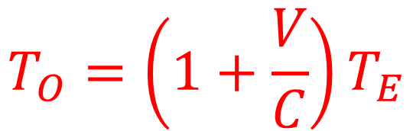


$$T_{O}=T_{E}+\frac{\sqrt{D^{2}+{\left(VT_{E}+L\right)}^{2}}}{C}$$
$$D=0$$
$$L=0$$
$$T_{O}=T_{E}+\frac{\sqrt{{\left(VT_{E}\right)}^{2}}}{C}$$
$$T_{O}=T_{E}+\frac{VT_{E}}{C}$$
$$T_{O}=\left(1+\frac{V}{C}\right)T_{E}$$

Slide 7


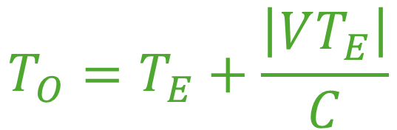


$$T_{O}=T_{E}+\frac{\sqrt{D^{2}+{\left(VT_{E}+L\right)}^{2}}}{C}$$
$$D=0$$
$$L=0$$
$$T_{O}=T_{E}+\frac{\sqrt{{\left(VT_{E}\right)}^{2}}}{C}$$
$$T_{O}=\left(1+\frac{V}{C}\right)T_{E}$$
$$T_{O}=T_{E}+\frac{\left|VT_{E}\right|}{C}$$

Slide 8








Perfect Square Solve
$$ax^{2}+2bx=0$$
$$B=\frac{b}{\sqrt{a}}$$
$$C=\frac{b^{2}}{a}$$
$$A=\sqrt{a}$$
$${\left(Ax+B\right)}^{2}=C$$
$${\left(\sqrt{a}x+\frac{b}{\sqrt{a}}\right)}^{2}=\frac{b^{2}}{a}$$
$$ax^{2}+2\sqrt{a}\frac{b}{\sqrt{a}}x+\frac{b^{2}}{a}=\frac{b^{2}}{a}$$
$$ax^{2}+2bx+\frac{b^{2}}{a}=\frac{b^{2}}{a}$$

Slide 9




$$T_{∆}=\frac{\sqrt{D^{2}+{\left(VT_{E}+L\right)}^{2}}}{C}$$
$$T_{E}=T_{O}−T_{∆}$$
$$T_{∆}=\frac{\sqrt{D^{2}+{\left(V\left(T_{O}−T_{∆}\right)+L\right)}^{2}}}{C}$$
$$T_{∆}=\frac{\sqrt{D^{2}+V^{2}{\left(T_{O}−T_{∆}\right)}^{2}+2VL\left(T_{O}−T_{∆}\right)+L^{2}}}{C}$$
$$C^{2}{T_{∆}}^{2}=D^{2}+V^{2}{\left(T_{O}−T_{∆}\right)}^{2}+2VL\left(T_{O}−T_{∆}\right)+L^{2}$$

Slide 10

$$C^{2}{T_{∆}}^{2}=D^{2}+V^{2}{\left(T_{O}−T_{∆}\right)}^{2}+2VL\left(T_{O}−T_{∆}\right)+L^{2}$$
$$C^{2}{T_{∆}}^{2}=D^{2}+V^{2}{T_{O}}^{2}−2V^{2}T_{O}T_{∆}$$
$+V^{2}{T_{∆}}^{2}+2VLT_{O}−2VLT_{∆}+L^{2}$
$P=$ $D^{2}+V^{2}{T_{O}}^{2}+2VLT_{O}+L^{2}$
$$C^{2}{T_{∆}}^{2}=P−2T_{O}{T_{∆}}^{2}+{V^{2}T_{∆}}^{2}−2VLT_{∆}$$
$$C^{2}{T_{∆}}^{2}−V^{2}{T_{∆}}^{2}+2\left(V^{2}T_{O}T_{∆}+VLT_{∆}\right)=P$$

Slide 11

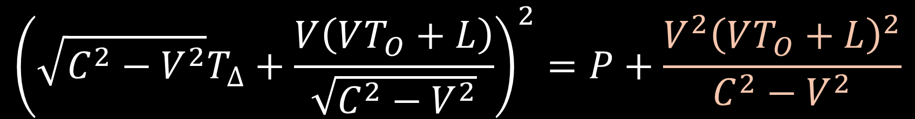
$$C^{2}{T_{∆}}^{2}−V^{2}{T_{∆}}^{2}+2\left(V^{2}T_{O}T_{∆}+VLT_{∆}\right)=P$$
$$\left(C^{2}−V^{2}\right){T_{∆}}^{2}+2VT_{∆}\left(VT_{O}+L\right)=P$$
$${\left(\sqrt{C^{2}−V^{2}}T_{∆}+\frac{V\left(VT_{O}+L\right)}{\sqrt{C^{2}−V^{2}}}\right)}^{2}=P+\frac{V^{2}{\left(VT_{O}+L\right)}^{2}}{C^{2}−V^{2}}$$
$$\sqrt{C^{2}−V^{2}}T_{∆}+\frac{V\left(VT_{O}+L\right)}{\sqrt{C^{2}−V^{2}}}$$
$=±\sqrt{P+\frac{V^{2}V^{2}{T_{O}}^{2}+2V^{2}VT_{O}L+V^{2}L^{2}}{C^{2}−V^{2}}}$

Slide 12


$P=$ $D^{2}+V^{2}{T_{O}}^{2}+2VLT_{O}+L^{2}$
$$\sqrt{C^{2}−V^{2}}T_{∆}+\frac{V\left(VT_{O}+L\right)}{\sqrt{C^{2}−V^{2}}}$$
$=\sqrt{P+\frac{V^{2}V^{2}{T_{O}}^{2}+2V^{2}VT_{O}L+V^{2}L^{2}}{C^{2}−V^{2}}}$
$$\sqrt{C^{2}−V^{2}}T_{∆}+\frac{V\left(VT_{O}+L\right)}{\sqrt{C^{2}−V^{2}}}$$
$=±\sqrt{\frac{\left(C^{2}−V^{2}\right)\left(D^{2}+V^{2}{T_{O}}^{2}+2VLT_{O}+L^{2}\right)}{C^{2}−V^{2}}+\frac{V^{2}V^{2}{T_{O}}^{2}+2V^{2}VT_{O}L+V^{2}L^{2}}{C^{2}−V^{2}}}$

Slide 13
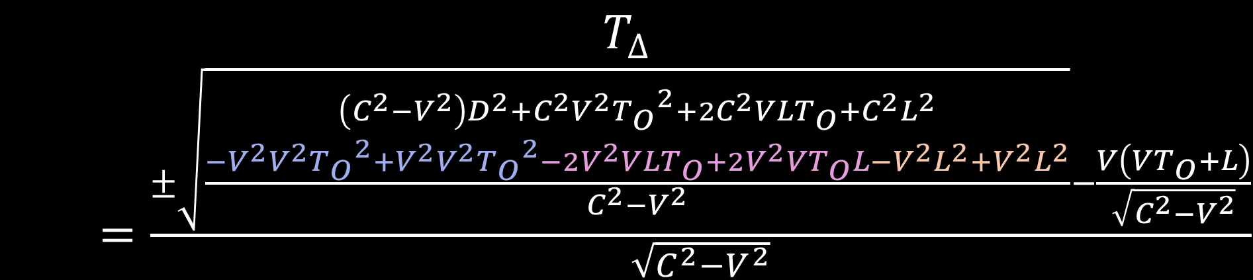

$$\sqrt{C^{2}−V^{2}}T_{∆}+\frac{V\left(VT_{O}+L\right)}{\sqrt{C^{2}−V^{2}}}$$
$=±\sqrt{\frac{\left(C^{2}−V^{2}\right)\left(D^{2}+V^{2}{T_{O}}^{2}+2VLT_{O}+L^{2}\right)}{C^{2}−V^{2}}+\frac{V^{2}V^{2}{T_{O}}^{2}+V^{2}VT_{O}L+V^{2}L^{2}}{C^{2}−V^{2}}}$
$$T_{∆}$$
$=\frac{±\sqrt{\frac{\begin{aligned}\left(C^{2}−V^{2}\right)D^{2}+C^{2}V^{2}{T_{O}}^{2}+2C^{2}VLT_{O}+C^{2}L^{2} \\ −V^{2}V^{2}{T_{O}}^{2}+V^{2}V^{2}{T_{O}}^{2}−2V^{2}VLT_{O}+{2V}^{2}VT_{O}L−V^{2}L^{2}+V^{2}L^{2}\end{aligned}}{C^{2}−V^{2}}}−\frac{V\left(VT_{O}+L\right)}{\sqrt{C^{2}−V^{2}}}}{\sqrt{C^{2}−V^{2}}}$

Slide 14



$$T_{∆}$$
$=\frac{±\sqrt{\frac{\begin{aligned}\left(C^{2}−V^{2}\right)D^{2}+C^{2}V^{2}{T_{O}}^{2}+2C^{2}VLT_{O}+C^{2}L^{2} \\ −V^{2}V^{2}{T_{O}}^{2}+V^{2}V^{2}{T_{O}}^{2}−2V^{2}VLT_{O}+{2V}^{2}VT_{O}L−V^{2}L^{2}+V^{2}L^{2}\end{aligned}}{C^{2}−V^{2}}}−\frac{V\left(VT_{O}+L\right)}{\sqrt{C^{2}−V^{2}}}}{\sqrt{C^{2}−V^{2}}}$
$$T_{∆}=\frac{±\sqrt{\left(C^{2}−V^{2}\right)D^{2}+C^{2}V^{2}{T_{O}}^{2}+2C^{2}VLT_{O}+C^{2}L^{2}}−V\left(VT_{O}+L\right)}{C^{2}−V^{2}}$$
$T_{∆}=$ $\frac{±\sqrt{\left(C^{2}−V^{2}\right)D^{2}+C^{2}{\left(VT_{O}+L\right)}^{2}}−V\left(VT_{O}+L\right)}{C^{2}−V^{2}}$

Slide 15


$T_{∆}=$ $\frac{±\sqrt{\left(C^{2}−V^{2}\right)D^{2}+C^{2}{\left(VT_{O}+L\right)}^{2}}−V\left(VT_{O}+L\right)}{C^{2}−V^{2}}$
The positive solution is good for V<C, the negative solution
should be checked if V>C; $T_{∆}$ must be positive.

Slide 16





$$T_{∆}=\frac{\sqrt{D^{2}+{\left(C\left(T_{O}−T_{∆}\right)+L\right)}^{2}}}{C}$$
$C^{2}{T_{∆}}^{2}=$ $D^{2}+$ $C^{2}{\left(T_{O}−T_{∆}\right)}^{2}+2CL\left(CT_{O}−CT_{∆}\right)+L^{2}$
$C^{2}{T_{∆}}^{2}=$ $D^{2}+$ $C^{2}{T_{O}}^{2}−2C^{2}T_{O}T_{∆}+C^{2}{T_{∆}}^{2}$
$$+2CLT_{O}−2CLT_{∆}+L^{2}$$
$C^{2}{T_{∆}}^{2}−C^{2}{T_{∆}}^{2}+\left(2CL+2C^{2}T_{O}\right)T_{∆}=$ $D^{2}+$ $C^{2}{T_{O}}^{2}$
$$+2CLT_{O}+L^{2}$$
$T_{∆}=$ $\frac{D^{2}+ {\left(CT_{O}+L\right)}^{2}}{\left(2CL+2C^{2}T_{O}\right)}$
$T_{∆}=$ $\frac{D^{2}+ {\left(CT_{O}+L\right)}^{2}}{2C\left(CT_{O}+L\right)}$

Slide 17









$$T_{E}=T_{O}−\frac{D^{2}+{\left(CT_{O}+L\right)}^{2}}{\left(2CL+2C^{2}T_{O}\right)}$$
$T_{∆}=$ $\frac{D^{2}+ {\left(CT_{O}+L\right)}^{2}}{\left(2CL+2C^{2}T_{O}\right)}$
$T_{∆}=$ $\frac{ {\left(CT_{O}\right)}^{2}}{\left(2C^{2}T_{O}\right)}$
$$T_{E}=\frac{T_{O}\left(2CL+2C^{2}T_{O}\right)−D^{2}−{\left(CT_{O}+L\right)}^{2}}{\left(2CL+2C^{2}T_{O}\right)}$$
$T_{∆}=$ $\frac{T_{O}}{2}$
$$T_{E}=\frac{C^{2}{T_{O}}^{2}−D^{2}−L^{2}}{\left(2CL+2C^{2}T_{O}\right)}$$
$T_{E}=$ $T_{O}−\frac{T_{O}}{2}$
$T_{E}=$ $\frac{T_{O}}{2}$
$T_{E}=$ $\frac{T_{O}}{2}$

Slide 18
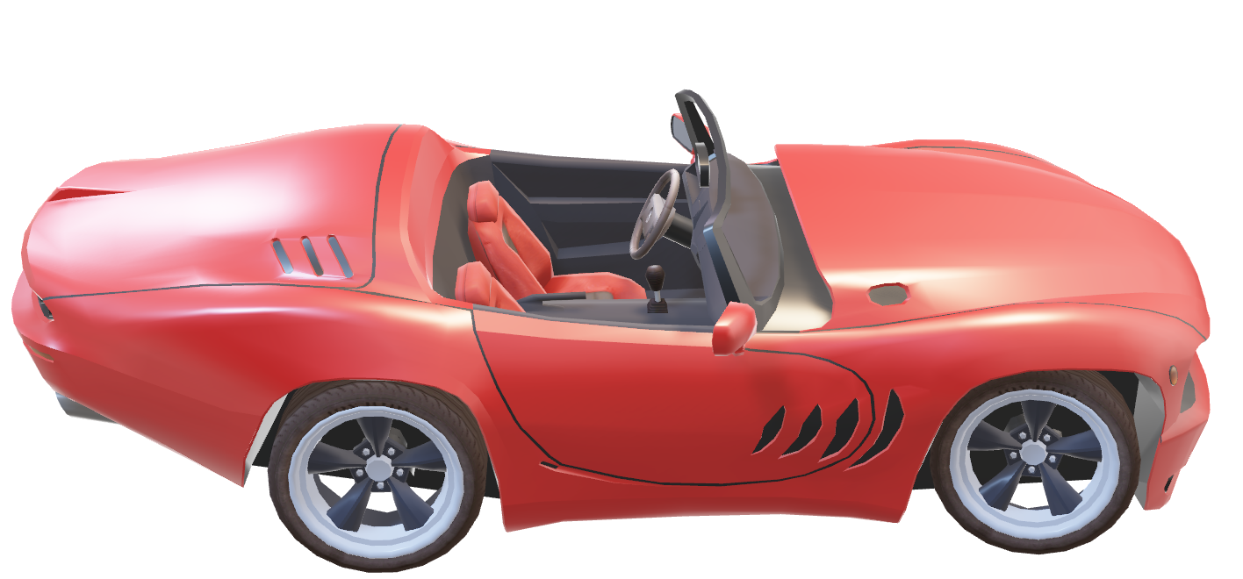

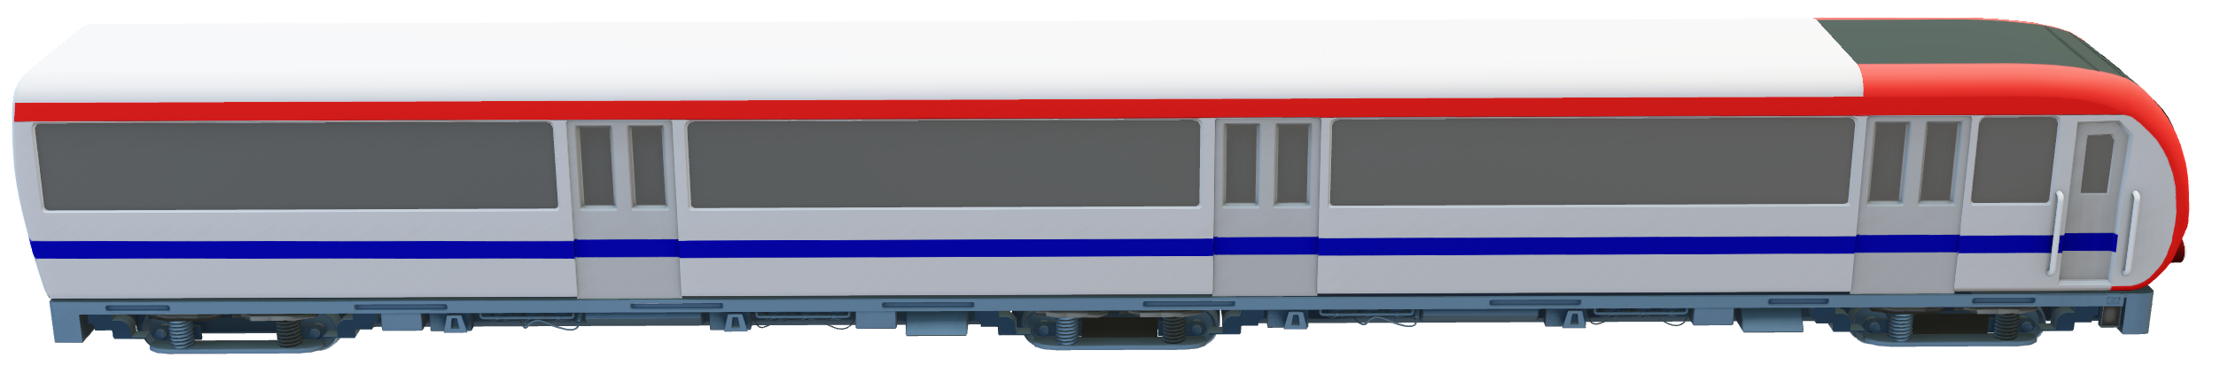
Relative Velocity
55
65
-10?
10?
What about when the car is at the driver? 0mph?

Slide 19
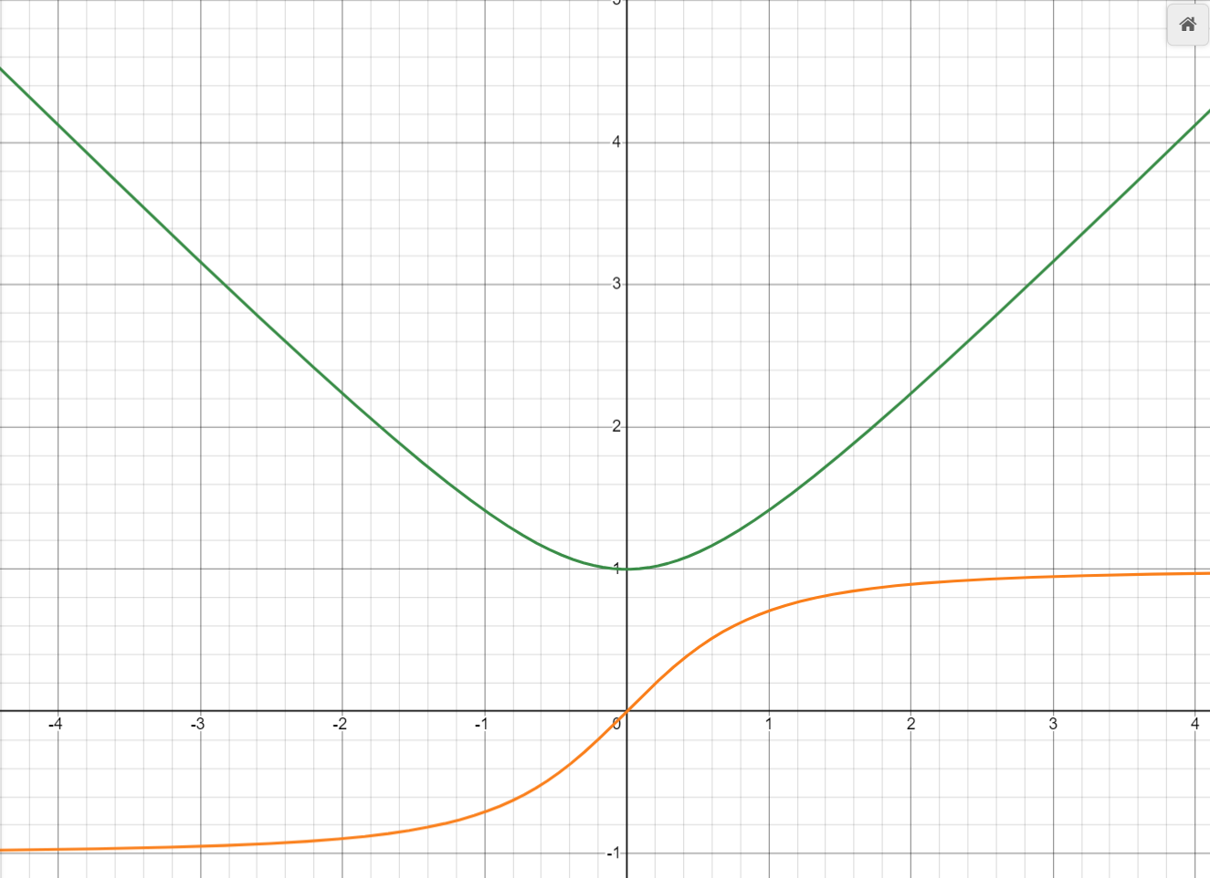
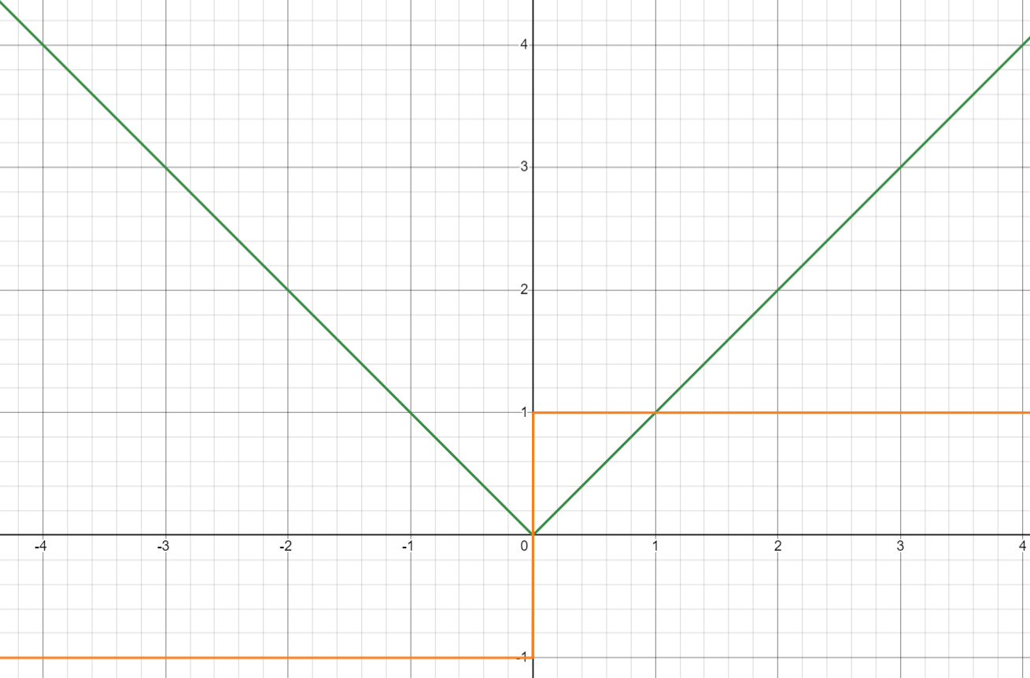




https://www.desmos.com/calculator/pnc4xaqpk0
Distance 1, Velocity 1
Distance 0, Velocity 1
$$R_{P}\left(t\right)=\left\|\vec{\{0,D,0\}}+\vec{\{V,0,0\}}t\right\|$$
$$R_{P}\left(t\right)=\sqrt{D^{2}+V^{2}t^{2}}$$
$$R_{V}\left(t\right)=\frac{V^{2}}{\sqrt{D^{2}+V^{2}t^{2}}}$$
$$R_{P}\left(t\right)=\left\|\vec{D}+\vec{V}t\right\|$$
Notes:
https://www.desmos.com/calculator/pnc4xaqpk0

Slide 20








Vector Math
$$\vec{V}=\left\{x,y,z,…\right\}$$
$$\left\|\vec{V}\right\|=\sqrt{x^{2}+y^{2}+z^{2}+…}$$
$$\vec{V}∙\vec{V}=xx+yy+zz+…$$
$$\vec{V}∙\vec{V}=x^{2}+y^{2}+z^{2}+…$$
$$\left\|\vec{V}\right\|=\sqrt{\vec{V}∙\vec{V}}$$
$\vec{V_{1}}+\vec{V_{2}}=$ $\left\{x_{1}+x_{2},y_{1}+y_{2},z_{1}+z_{2},…\right\}$
$${\vec{V}}^{2}=\vec{V}∙\vec{V}$$
$\vec{V_{1}}−\vec{V_{2}}=$ $\left\{x_{1}−x_{2},y_{1}−y_{2},z_{1}−z_{2},…\right\}$
$$\left\|\vec{V}\right\|=\sqrt{{\vec{V}}^{2}}$$
$\vec{V}T=$ $\left\{xT,yT,zT,…\right\}$

Slide 21
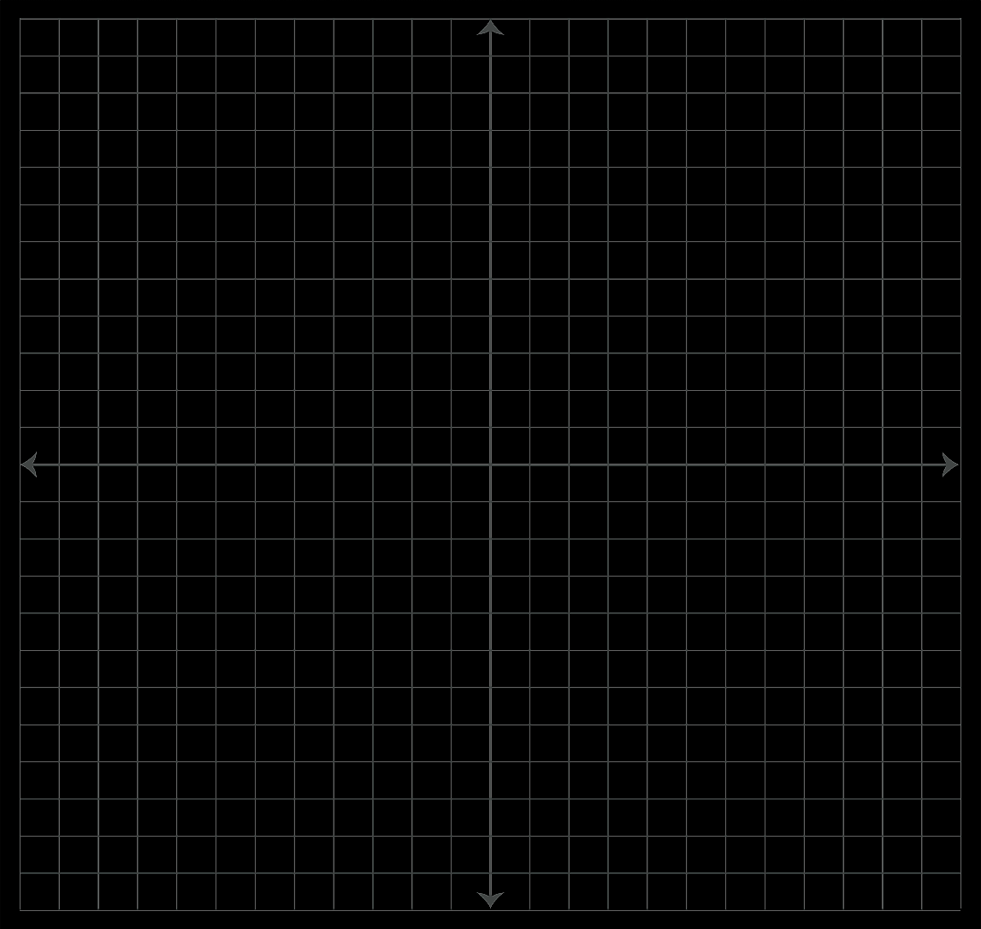


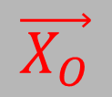

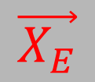


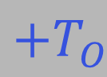
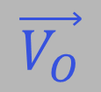

$$\vec{V_{E}}$$
$$+T_{E}$$
$$\vec{X_{E}}$$
$$−T_{E}$$
$$\vec{X_{O}}$$
$$−T_{O}$$
$$\vec{V_{O}}$$
$$\vec{X_{E}}+\vec{V_{E}}T_{E}$$
$$\vec{X_{O}}+\vec{V_{O}}T_{O}$$
$$+T_{O}$$

Slide 22




3D Math
$$T_{O}=T_{E}+\frac{\left\|\left(\vec{X_{E}}+\vec{V_{E}}T_{E}\right)−\left(\vec{X_{O}}+\vec{V_{O}}T_{O}\right)\right\| }{C}$$
$$T_{O}=T_{E}+\frac{\sqrt{{\left(\left(\vec{X_{E}}+\vec{V_{E}}T_{E}\right)−\left(\vec{X_{O}}+\vec{V_{O}}T_{O}\right)\right)}^{2}}}{C}$$
$$P=\left(\vec{X_{E}}\right)−\left(\vec{X_{O}}+\vec{V_{O}}T_{O}\right)$$
$$T_{O}=T_{E}+\frac{\sqrt{{\left(P+\vec{V_{E}}T_{E}\right)}^{2}}}{C}$$

Slide 23


$$T_{O}=T_{E}+\frac{\sqrt{{\left(P+\vec{V_{E}}T_{E}\right)}^{2}}}{C}$$
$$C\left(T_{O}−T_{E}\right)=\sqrt{{\left(P+\vec{V_{E}}T_{E}\right)}^{2}}$$
$$C^{2}{\left(T_{O}−T_{E}\right)}^{2}=P^{2}+2P\vec{V_{E}}T_{E}+{\vec{V_{E}}}^{2}{T_{E}}^{2}$$
$$C^{2}{T_{O}}^{2}−2C^{2}T_{O}T_{E}+C^{2}{T_{E}}^{2}=P^{2}+2P\vec{V_{E}}T_{E}+{\vec{V_{E}}}^{2}{T_{E}}^{2}$$
$$C^{2}{T_{E}}^{2}−{\vec{V_{E}}}^{2}{T_{E}}^{2}−2C^{2}T_{O}T_{E}−2P\vec{V_{E}}T_{E}=P^{2}−C^{2}{T_{O}}^{2}$$
$$\left(C^{2}−{\vec{V_{E}}}^{2}\right){T_{E}}^{2}−2\left(C^{2}T_{O}+P\vec{V_{E}}\right)T_{E}=P^{2}−C^{2}{T_{O}}^{2}$$
Notes:
… Which leads to the hard part…

Slide 24

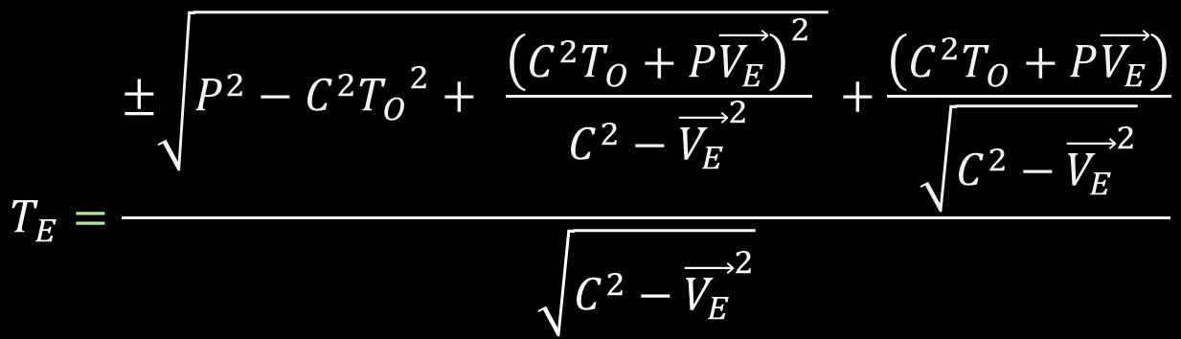

$$\left(C^{2}−{\vec{V_{E}}}^{2}\right){T_{E}}^{2}−2\left(C^{2}T_{O}+P\vec{V_{E}}\right)T_{E}=P^{2}−C^{2}{T_{O}}^{2}$$
${\left(\sqrt{C^{2}−{\vec{V_{E}}}^{2}}T_{E}−\frac{\left(C^{2}T_{O}+P\vec{V_{E}}\right)}{\sqrt{C^{2}−{\vec{V_{E}}}^{2}}}\right)}^{2}=P^{2}−C^{2}{T_{O}}^{2}+$ $\frac{{\left(C^{2}T_{O}+P\vec{V_{E}}\right)}^{2}}{C^{2}−{\vec{V_{E}}}^{2}}$
$$\sqrt{C^{2}−{\vec{V_{E}}}^{2}}T_{E}−\frac{\left(C^{2}T_{O}+P\vec{V_{E}}\right)}{\sqrt{C^{2}−{\vec{V_{E}}}^{2}}}=±\sqrt{P^{2}−C^{2}{T_{O}}^{2}+ \frac{{\left(C^{2}T_{O}+P\vec{V_{E}}\right)}^{2}}{C^{2}−{\vec{V_{E}}}^{2}} }$$
$$T_{E}=\frac{±\sqrt{P^{2}−C^{2}{T_{O}}^{2}+ \frac{{\left(C^{2}T_{O}+P\vec{V_{E}}\right)}^{2}}{C^{2}−{\vec{V_{E}}}^{2}} }+\frac{\left(C^{2}T_{O}+P\vec{V_{E}}\right)}{\sqrt{C^{2}−{\vec{V_{E}}}^{2}}}}{\sqrt{C^{2}−{\vec{V_{E}}}^{2}}}$$

Slide 25
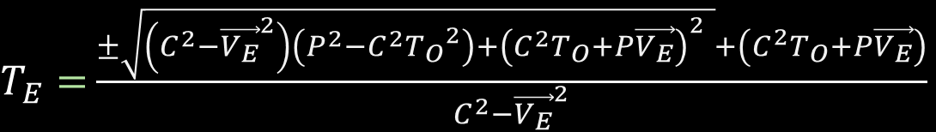

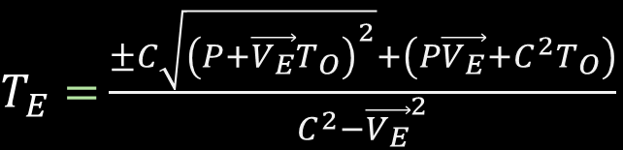
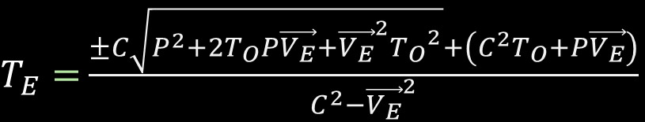
$$T_{E}=\frac{±\sqrt{P^{2}−C^{2}{T_{O}}^{2}+ \frac{{\left(C^{2}T_{O}+P\vec{V_{E}}\right)}^{2}}{C^{2}−{\vec{V_{E}}}^{2}} }+\frac{\left(C^{2}T_{O}+P\vec{V_{E}}\right)}{\sqrt{C^{2}−{\vec{V_{E}}}^{2}}}}{\sqrt{C^{2}−{\vec{V_{E}}}^{2}}}$$
$T_{E}=$ $\frac{±\sqrt{\left(C^{2}−{\vec{V_{E}}}^{2}\right)\left(P^{2}−C^{2}{T_{O}}^{2}\right)+{\left(C^{2}T_{O}+P\vec{V_{E}}\right)}^{2} }+\left(C^{2}T_{O}+P\vec{V_{E}}\right)}{C^{2}−{\vec{V_{E}}}^{2}}$
$T_{E}=$ $\frac{±\sqrt{C^{2}P^{2}−{\vec{V_{E}}}^{2}P^{2}{−C}^{2}C^{2}{T_{O}}^{2}+{\vec{V_{E}}}^{2}C^{2}{T_{O}}^{2}+C^{2}T_{O}C^{2}T_{O}+2C^{2}T_{O}P\vec{V_{E}}+P\vec{V_{E}}P\vec{V_{E}} }+\left(C^{2}T_{O}+P\vec{V_{E}}\right)}{C^{2}−{\vec{V_{E}}}^{2}}$
$T_{E}=$ $\frac{±C\sqrt{P^{2}+2T_{O}P\vec{V_{E}}+{\vec{V_{E}}}^{2}{T_{O}}^{2}}+\left(C^{2}T_{O}+P\vec{V_{E}}\right)}{C^{2}−{\vec{V_{E}}}^{2}}$
$T_{E}=$ $\frac{±C\sqrt{{\left(P+\vec{V_{E}}T_{O}\right)}^{2}}+\left(P\vec{V_{E}}+C^{2}T_{O}\right)}{C^{2}−{\vec{V_{E}}}^{2}}$

Slide 26



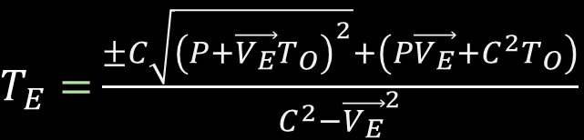


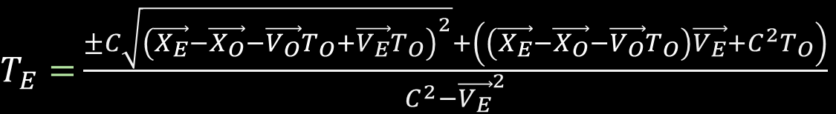
$T_{E}=$ $\frac{±C\sqrt{{\left(P+\vec{V_{E}}T_{O}\right)}^{2}}+\left(P\vec{V_{E}}+C^{2}T_{O}\right)}{C^{2}−{\vec{V_{E}}}^{2}}$
$$P=\left(\vec{X_{E}}\right)−\left(\vec{X_{O}}+\vec{V_{O}}T_{O}\right)$$
$T_{E}=$ $\frac{±C\sqrt{{\left(\vec{X_{E}}−\vec{X_{O}}−\vec{V_{O}}T_{O}+\vec{V_{E}}T_{O}\right)}^{2}}+\left(\left(\vec{X_{E}}−\vec{X_{O}}−\vec{V_{O}}T_{O}\right)\vec{V_{E}}+C^{2}T_{O}\right)}{C^{2}−{\vec{V_{E}}}^{2}}$
$T_{E}=$ $\frac{−C\sqrt{{\left(\vec{X_{E}}−\vec{X_{O}}+\left(\vec{V_{E}}−\vec{V_{O}}\right)T_{O}\right)}^{2}}+\left(\vec{X_{E}}−\vec{X_{O}}\right)\vec{V_{E}}+\left(C^{2}−\vec{V_{O}}\vec{V_{E}}\right)T_{O}}{C^{2}−{\vec{V_{E}}}^{2}}$
$$V<C$$
$T_{E}=$ $\frac{C\sqrt{{\left(\vec{X_{E}}−\vec{X_{O}}+\left(\vec{V_{E}}−\vec{V_{O}}\right)T_{O}\right)}^{2}}+\left(\vec{X_{E}}−\vec{X_{O}}\right)\vec{V_{E}}+\left(C^{2}−\vec{V_{O}}\vec{V_{E}}\right)T_{O}}{C^{2}−{\vec{V_{E}}}^{2}}$
$$V>C$$
If (Te < To) then the result is valid…

Slide 27









$$T_{O}=T_{E}+\frac{\sqrt{{\left(\left(\vec{X_{E}}+\vec{V_{E}}T_{E}\right)−\left(\vec{X_{O}}+\vec{V_{O}}T_{O}\right)\right)}^{2}}}{C}$$
$$V_{E}=C$$
$$T_{O}=T_{E}+\frac{\sqrt{{\left(\left(\vec{X_{E}}+\vec{V_{E}}T_{E}\right)−\left(\vec{X_{O}}+\vec{V_{O}}T_{O}\right)\right)}^{2}}}{\vec{V_{E}}}$$
$$\sqrt{{\vec{V_{E}}}^{2}}\left(T_{O}−T_{E}\right)=\sqrt{P^{2}+2P\vec{V_{E}}T_{E}+C^{2}{T_{E}}^{2}}$$
$$P=\left(\vec{X_{E}}\right)−\left(\vec{X_{O}}+\vec{V_{O}}T_{O}\right)$$
$${\vec{V_{E}}}^{2}{T_{O}}^{2}−2{\vec{V_{E}}}^{2}T_{O}T_{E}+{\vec{V_{E}}}^{2}{T_{E}}^{2}=P^{2}+2P\vec{V_{E}}T_{E}+{\vec{V_{E}}}^{2}{T_{E}}^{2}$$
$$T_{O}=T_{E}+\frac{\sqrt{{\left(P+\vec{V_{E}}T_{E}\right)}^{2}}}{\sqrt{{\vec{V_{E}}}^{2}}}$$
$$−2{\vec{V_{E}}}^{2}T_{O}T_{E}−2P\vec{V_{E}}T_{E}=P^{2}−{\vec{V_{E}}}^{2}{T_{O}}^{2}$$
$$T_{E}=\frac{P^{2}−{\vec{V_{E}}}^{2}{T_{O}}^{2}}{−2\left({\vec{V_{E}}}^{2}T_{O}+P\vec{V_{E}}\right)}$$
$$T_{O}=T_{E}+\frac{\sqrt{P^{2}+2P\vec{V_{E}}T_{E}+{\vec{V_{E}}}^{2}{T_{E}}^{2}}}{\sqrt{{\vec{V_{E}}}^{2}}}$$
$$T_{E}=\frac{{\left(\left(\vec{X_{E}}\right)−\left(\vec{X_{O}}+\vec{V_{O}}T_{O}\right)\right)}^{2}−{\vec{V_{E}}}^{2}{T_{O}}^{2}}{−2\left({\vec{V_{E}}}^{2}T_{O}+\left(\left(\vec{X_{E}}\right)−\left(\vec{X_{O}}+\vec{V_{O}}T_{O}\right)\right)\vec{V_{E}}\right)}$$

Slide 28


$$T_{E}=\frac{{\left(\left(\vec{X_{E}}\right)−\left(\vec{X_{O}}+\vec{V_{O}}T_{O}\right)\right)}^{2}−{\vec{V_{E}}}^{2}{T_{O}}^{2}}{−2\left({\vec{V_{E}}}^{2}T_{O}+\left(\left(\vec{X_{E}}\right)−\left(\vec{X_{O}}+\vec{V_{O}}T_{O}\right)\right)\vec{V_{E}}\right)}$$
$$T_{E}=\frac{{\left(\left(\vec{X_{E}}\right)−\left(\vec{X_{O}}+\vec{V_{O}}T_{O}\right)\right)}^{2}−C^{2}{T_{O}}^{2}}{−2\left(C^{2}T_{O}+\left(\left(\vec{X_{E}}\right)−\left(\vec{X_{O}}+\vec{V_{O}}T_{O}\right)\right)\vec{V_{E}}\right)}$$

Slide 29



A Different $C$ Constant
$$C=\frac{distance}{time unit}$$
Velocity
Distance
$$C_{L}=C∙1\left(time units\right)$$

Slide 30
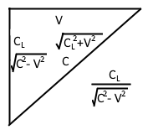






Setup for Length Contraction
$$\frac{C_{L}}{C−V}$$
$$C−V$$
$$\sqrt{C^{2}−V^{2}}$$
$\frac{C_{L}}{\sqrt{C^{2}−V^{2}}}$ (time)
$$\frac{C_{L}}{C+V}$$
$$C+V$$

Slide 31

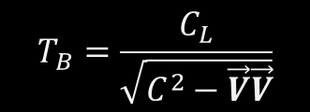
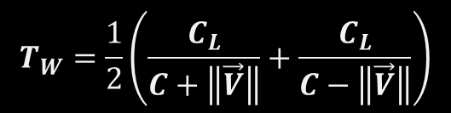




Length Contraction
$$T_{W}=\frac{1}{2}\left(\frac{C_{L}}{C+\left\|\vec{V}\right\|}+\frac{C_{L}}{C−\left\|\vec{V}\right\|}\right)$$
$$T_{B}=\frac{C_{L}}{\sqrt{C^{2}−\vec{V}\vec{V}}}$$
$$T_{W}=\frac{1}{2}\left(\frac{2CC_{L}}{C^{2}−\vec{V}\vec{V}}\right)$$
$$\frac{T_{B}}{T_{W}}=\frac{\frac{C_{L}}{\sqrt{{C_{L}}^{2}−\vec{V}\vec{V}}}}{\frac{CC_{L}}{C^{2}−\vec{V}\vec{V}}}=\frac{C_{L}}{\sqrt{C^{2}−\vec{V}\vec{V}}}\frac{C^{2}−\vec{V}\vec{V}}{CC_{L}}$$
$$T_{W}=\frac{CC_{L}}{C^{2}−\vec{V}\vec{V}}$$
$$Γ=\frac{T_{B}}{T_{W}}=\frac{\sqrt{C^{2}−\vec{V}\vec{V}}}{C}=\sqrt{1−\frac{{\vec{V}}^{2}}{C^{2}}}$$
$$γ=\frac{1}{Γ}$$

Slide 32
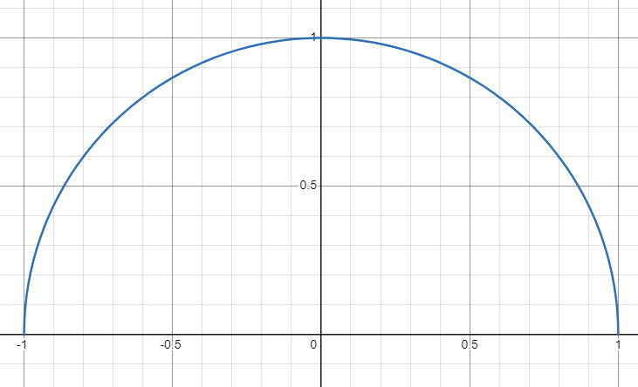

$$\frac{\sqrt{C^{2}−x^{2}}}{C}$$

Slide 33
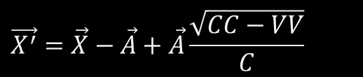
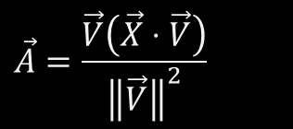
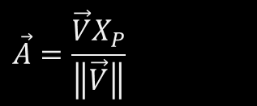
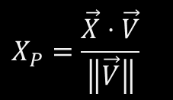
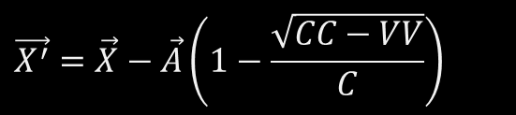
Applied Length Contraction Along Velocity
$$X_{P}=\frac{\vec{X}⋅\vec{V}}{\left\|\vec{V}\right\|}$$
$$\vec{A}=\frac{\vec{V}X_{P}}{\left\|\vec{V}\right\|}$$
$$\vec{A}=\frac{\vec{V}\left(\vec{X}⋅\vec{V}\right)}{{\left\|\vec{V}\right\|}^{2}}$$
$$\vec{X^{′}}=\vec{X}−\vec{A}+\vec{A}\frac{\sqrt{CC−VV}}{C}$$
$$\vec{X^{′}}=\vec{X}−\vec{A}\left(1−\frac{\sqrt{CC−VV}}{C}\right)$$

Slide 34
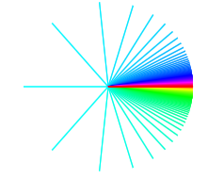
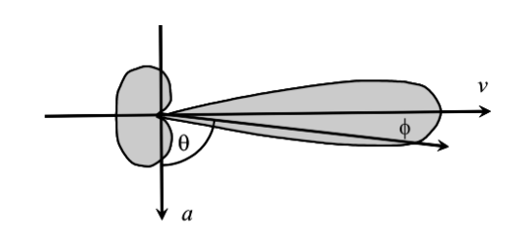
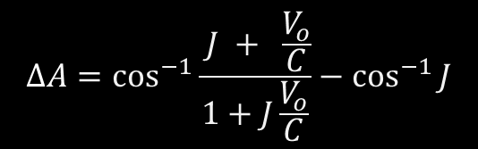
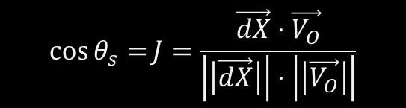

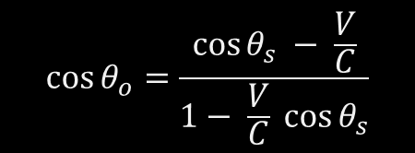
Light Aberration
$$\cos{θ_{o}}=\frac{\cos{θ_{s}} − \frac{V}{C}}{1− \frac{V}{C} \cos{θ_{s}}}$$
$$\vec{dX}=\left(\vec{X_{E}}−\vec{X_{O}}\right)$$
$$\cos{θ_{s}=}J=\frac{\vec{dX}⋅\vec{V_{O}}}{\left|\left|\vec{dX}\right|\right|⋅\left|\left|\vec{V_{O}}\right|\right|}$$
$$ΔA=\cos^{−1}{\frac{ J + \frac{V_{o}}{C}}{1+J\frac{V_{o}}{C}}}−\cos^{−1}{J}$$

Slide 35
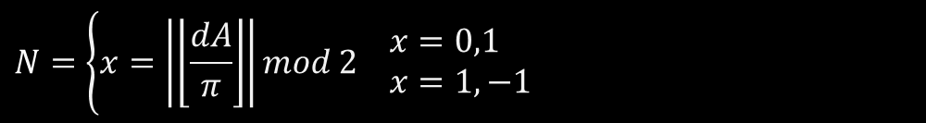


$$dA=D−A$$
$$N=\left\{x=\left|\left\lfloor \frac{dA}{π}\right\rfloor \right|mod 2 \begin{aligned}& x=0,1 \\ & x=1,−1\end{aligned}\right.$$
$$b=N∗\cos^{−1}{\frac{V−C\cos{dA}}{V\cos{dA}−C}}+D$$

Slide 36

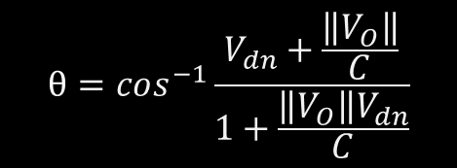

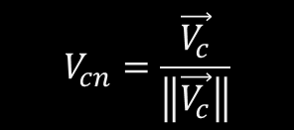

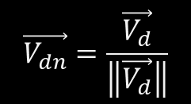
$$\vec{ΔX_{d}}=\vec{X}−\vec{X_{O}}$$
$$V_{cn}=\frac{\vec{V_{c}}}{\left\|\vec{V_{c}}\right\|}$$
$$\vec{V_{dn}}=\frac{\vec{V_{d}}}{\left\|\vec{V_{d}}\right\|}$$
$$\vec{V_{c}}=\vec{ΔX_{d}}×\vec{V_{O}}$$
$$\vec{V_{d}}=\vec{ΔX_{d}}⋅\vec{V_{O}}$$
(velocity cross delta position)
(velocity dot delta position)
$$θ=cos^{−1}\frac{V_{dn}+\frac{\left\|V_{O}\right\|}{C}}{1+\frac{\left\|V_{O}\right\|V_{dn}}{C}}$$
$$\vec{X_{r}}=\vec{X_{O}}+\cos\left(θ\right)\vec{ΔX_{d}}+\sin\left(θ\right)\left(\vec{V_{C}}×\vec{ΔX_{d}}\right)+\left(\left(1−\cos{θ}\right)\vec{V_{c}}⋅\vec{ΔX_{d}}\right)\vec{ΔV_{cn}}$$

Slide 37
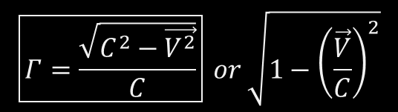

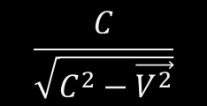
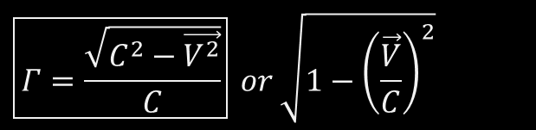
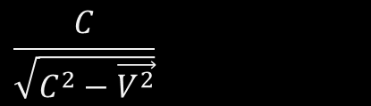
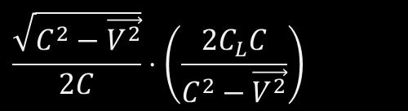
Time Contraction
$$T_{W}=\frac{1}{2}∙\frac{\sqrt{C^{2}−V^{2}}}{C}\left(\frac{C_{L}}{\left(C+V\right)}+\frac{C_{L}}{\left(C−V\right)}\right)$$
$$\frac{\sqrt{C^{2}−\vec{V^{2}}}}{2C}⋅\left(\frac{2C_{L}C}{C^{2}−\vec{V^{2}}}\right)$$
$$\frac{C}{\sqrt{C^{2}−\vec{V^{2}}}}$$
$$\frac{C}{\sqrt{C^{2}−\vec{V^{2}}}}$$
$$\boxed{Γ=\frac{\sqrt{C^{2}−\vec{V^{2}}}}{C}} or \sqrt{1−{\left(\frac{\vec{V}}{C}\right)}^{2}}$$
$$\boxed{Γ=\frac{\sqrt{C^{2}−\vec{V^{2}}}}{C}} or \sqrt{1−{\left(\frac{\vec{V}}{C}\right)}^{2}}$$

Slide 38
https://d3x0r.github.io/STFRPhysics/math/indexLightSpeed.html
https://d3x0r.github.io/STFRPhysics/math/indexLightSpeed1.html
https://d3x0r.github.io/STFRPhysics/math/indexLightSpeed2a.html
https://d3x0r.github.io/STFRPhysics/math/indexLightSpeed3b.html
https://d3x0r.github.io/Voxelarium.js/index2-dual-view.html
https://d3x0r.github.io/STFRPhysics/math/indexLightSpeed4.html
https://d3x0r.github.io/STFRPhysics/math/indexInterferometer4.html

Slide 39
https://d3x0r.github.io/STFRPhysics/math/indexLightSpeed-Clocks.html
https://d3x0r.github.io/STFRPhysics/math/indexLightSpeed4-wheel.html

Slide 40
www.youtube.com/user/3zdayz (J Decker)
www.youtube.com/@3zdayz/videos
www.github.com/d3x0r (Jim B)
www.github.com/d3x0r/STFRPhysics

